Slide 1
Mobile Application For Preparation of Nutritional And Healthy Food With Affordable And Available Recipes

Slide 2
MALNUTRITION
Malnutrition refers to a pathological state in which children and adults are suffering from deficiency or excess of one or more nutrients leading to the point where the body can no longer perform proper body functions

Slide 3
Causes of MALNUTRITION
Lack of awareness in nutrition, balanced diet, nutrient content of different food groups, cooking and food preserving methods

Slide 4
PROJECT MISSION
To guide families to create the best nutritional diet that make a healthy (mentally and physically) and well-nourished children.
To help every mother in Eritrea to prepare the best nutritional diet as much as possible with an affordable and available groceries.

Slide 5
PROJECT GOALS
To help every mother in every location in Eritrea prepare the best nutritional food with affordable groceries available within its local market.
To tackle malnutrition in the coming decade, in co-operation with other sectors such as ministries of health, agriculture and education and contribute to make well-nourished, strong, mentally and physically healthy youth that will build a healthy and strong nation.
To improve the nutritional status, health, growth, development and the survival of infants and young children, through optimal feeding practices.

Slide 6
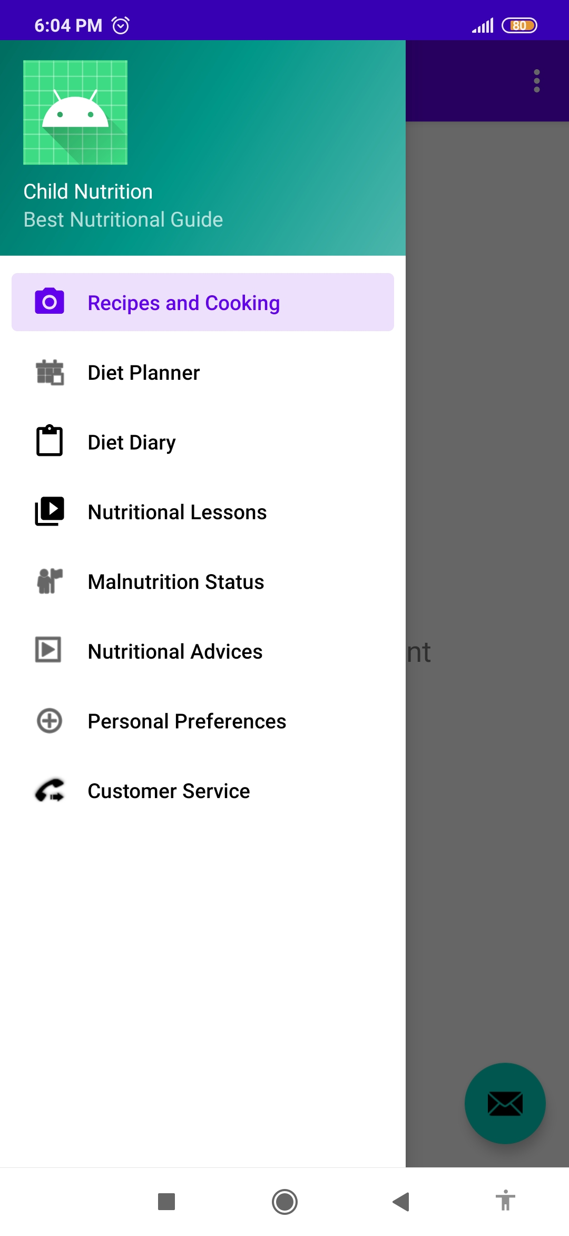
SYSTEM FEATURES
Offline database of food recipes
Malnutrition Calculator
Personalized diet planner
Grocery list provider
Diet Diary
Notifications and reminders
Educational information and lessons of nutrition
Customer support services

Slide 7
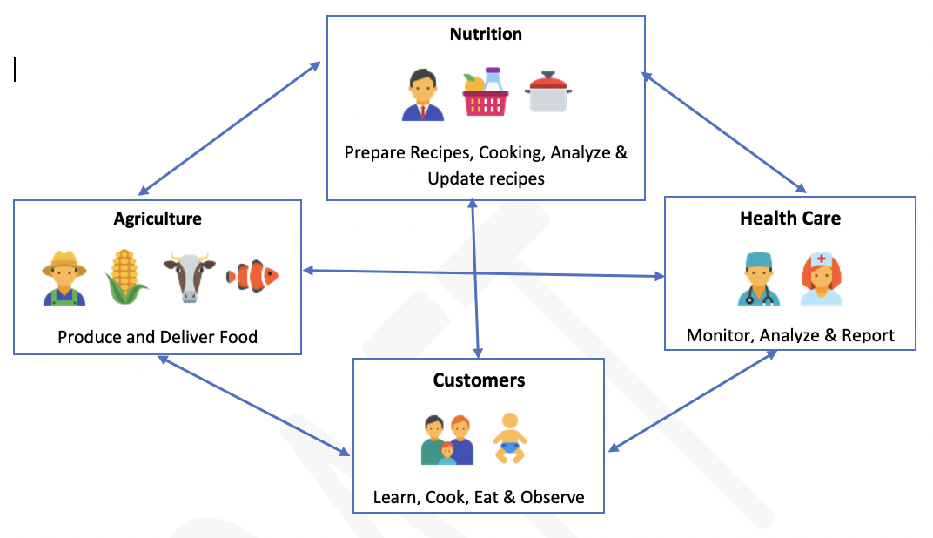
PROJECT ECOSYSTEM

Slide 8
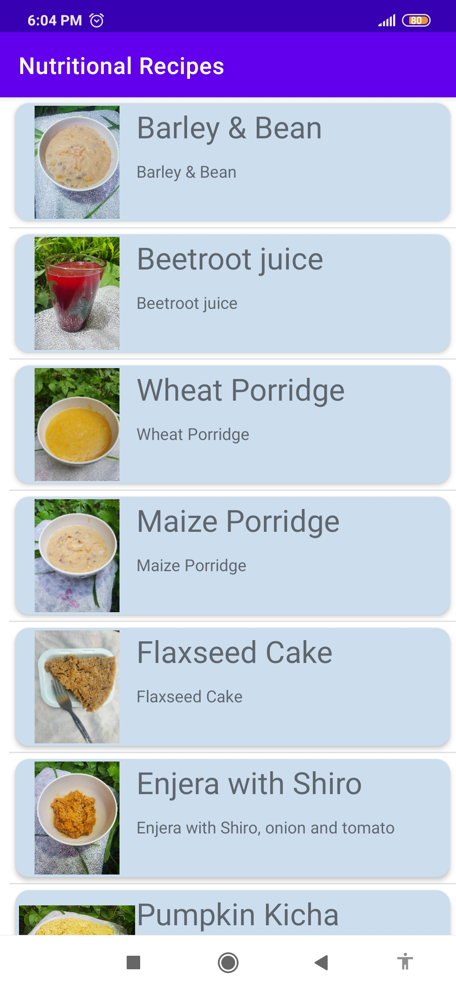
RECIPES
Contains list of recipes and the groceries to cook them
Describes ways of cooking it

Slide 9
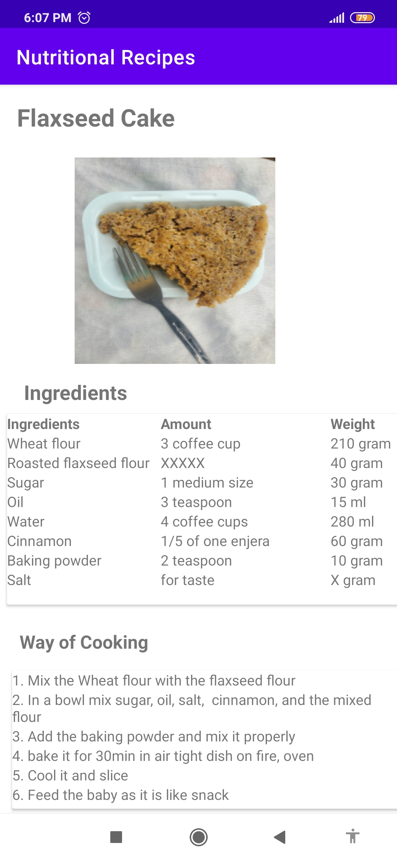
RECIPES…
Groceries to cook them
Describes ways of cooking it

Slide 10
STATUS DETECTION
Calculates the status of the person, in relation to his weight and height.
Checks whether you are malnourished, well-nourished or obese.

Slide 11
DIARY
Records your daily eating and its effects in your body.
If the recommended eating plan and practices don’t work properly, it suggests new plan or informs to your doctor.

Slide 12
CUSTOMER PREFERENCES
Customer preferences are settings the customer can set in order to customize his eating habits.
It includes: Area of living, Food groceries that he can find, His tastes and likes …. etc.

Slide 13
CUSTOMER SERVICE
Central customer service is necessary to get feedback from user and answer his questions.
It includes voice call and SMS.

Slide 14
CUSTOMER SERVICE
Central customer service is necessary to get feedback from user and answer his questions.
It includes voice call and SMS.

Slide 15
Phases of development
Phase 1: Data Collection
Phase 2: Food Fortification and System Design
Phase 3: Pilot App Trial
Phase 4: Mass App Distribution and implementation research
Phase 5: Customer Usage and System Customization

Slide 16
Research and Analysis
Comprehensive nutrient gap assessment (CONGA)
Development of food composition Databases(FCDB)
Development of local healthy food baskets and recipes that meet both recommended nutrient intake values
Development of dietary guidelines
Food systems transformation including innovations around household and industrial fortifications

Slide 17
Team Members
Roles | Team
System design and development | Eng. Simon Okbagergis Manna, BSc. Computer Engineering
Identification of nutritional value of local foods and recipe preparation | Eden Tareke, PhD, Nutrition
 | Nahom Daniel, MD.
 | Salina Nigusse, BSc, Food Technology
 | Tsinat Berhane
Implementation Research | Mulugeta Russom, MSc., PhD Candidate, Pharmacoepidemiology and Pharmacovigilance
 | Nahom Daniel, MD.

